Slide 1




IF IT’S EASY ,ANYONE ELSE CAN DO IT

Slide 2
CONTENT
About the Company
OUR VISION
OUR MISSION
OUR TEAM
OUR PROJECTS & STAKHOLDERS
OUR PLATFORM & GAMES
OUR RECENT PROJECT
THE PROJECT CONTENT
HOMEPAGE CONTENT
SINING UP STEPS
LOGIN STEPS
FINAL PRODUCT & GAME TUTORIAL
CONTACT US

Slide 3
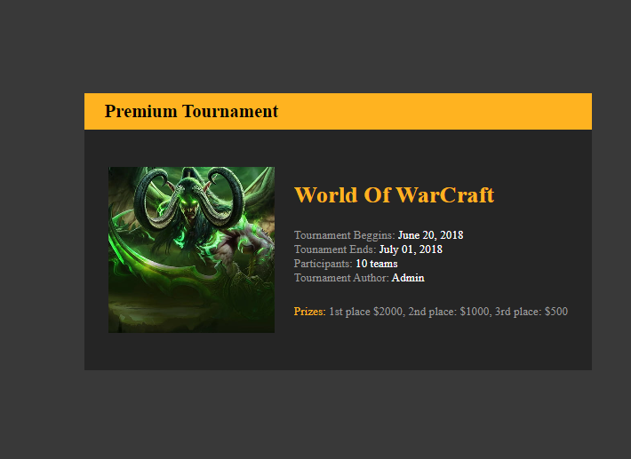
ABOUT US
We are an international game development company dedicated to creating engaging online games. Our platform serves as a showcase for our innovative products, allowing players to connect and enjoy a unique gaming experience.

Slide 4
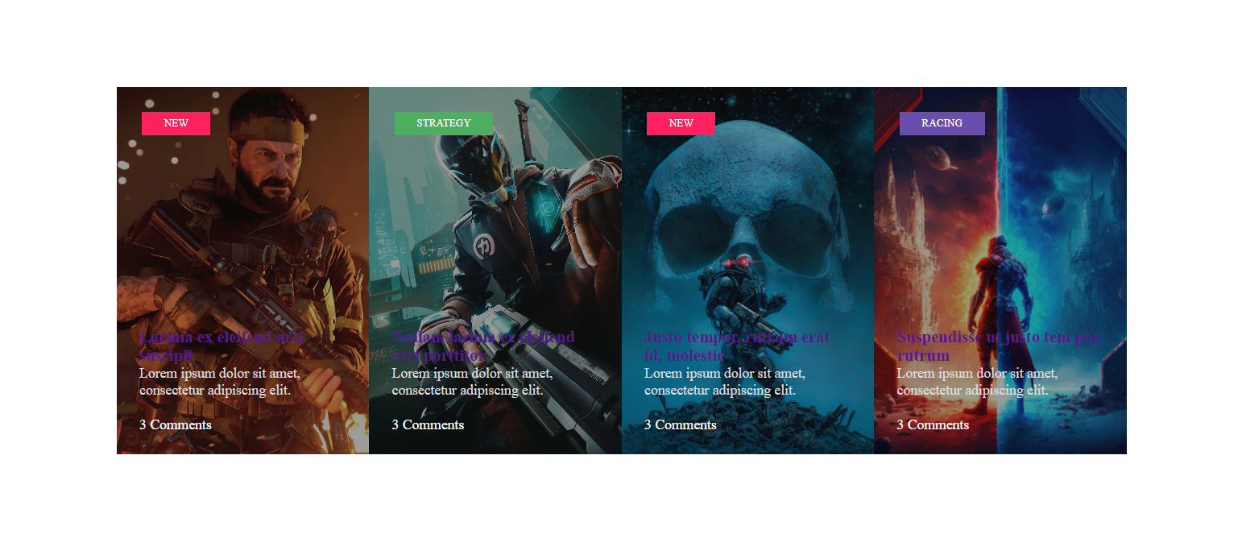
OUR VISION
To become a leading name in the online gaming industry by developing high-quality, interactive games that foster community and creativity among players worldwide.

Slide 5

OUR MISSION
Our mission is to deliver exceptional gaming experiences by focusing on user engagement, innovative gameplay, and continuous improvement based on player feedback.

Slide 6





OUR PROJECTS & STAKHOLDERS
We have successfully launched several projects in the past, collaborating with various stakeholders, including gaming platforms and tech partners. Our recent projects include educational games and multiplayer experiences that have received positive feedback from players.

Slide 7
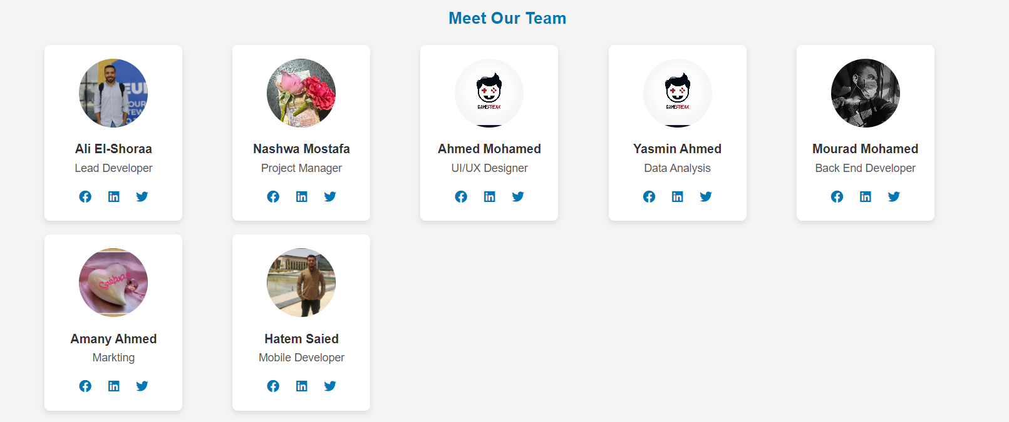
OUR TEAM
Our team consists of talented game designers, developers, and marketers who bring diverse skills and creativity to the Connect 4 project. Each member is committed to ensuring the game's success and enhancing player satisfaction.

Slide 8
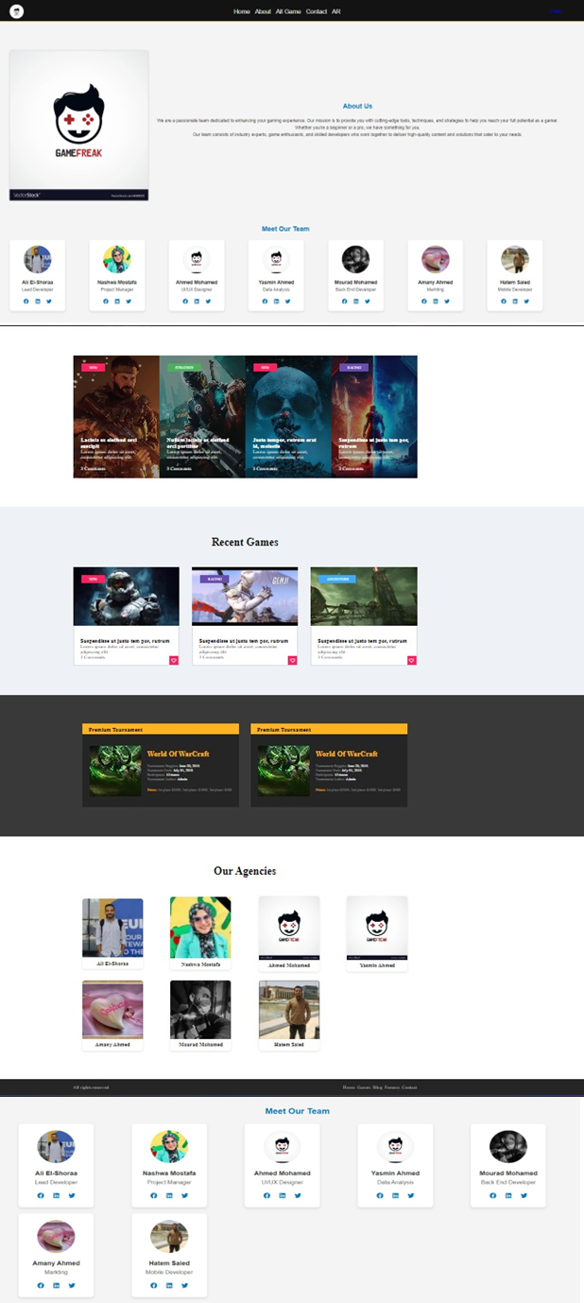
Our PLATFORM
Our platform features a user-friendly interface that supports seamless gameplay and social interaction. In addition to Connect 4, we offer a range of games, including puzzles, strategy games, and casual multiplayer experiences.
Here’s the link to our platform can takes you directly there
https://final-project-eui.netlify.app/

Slide 9
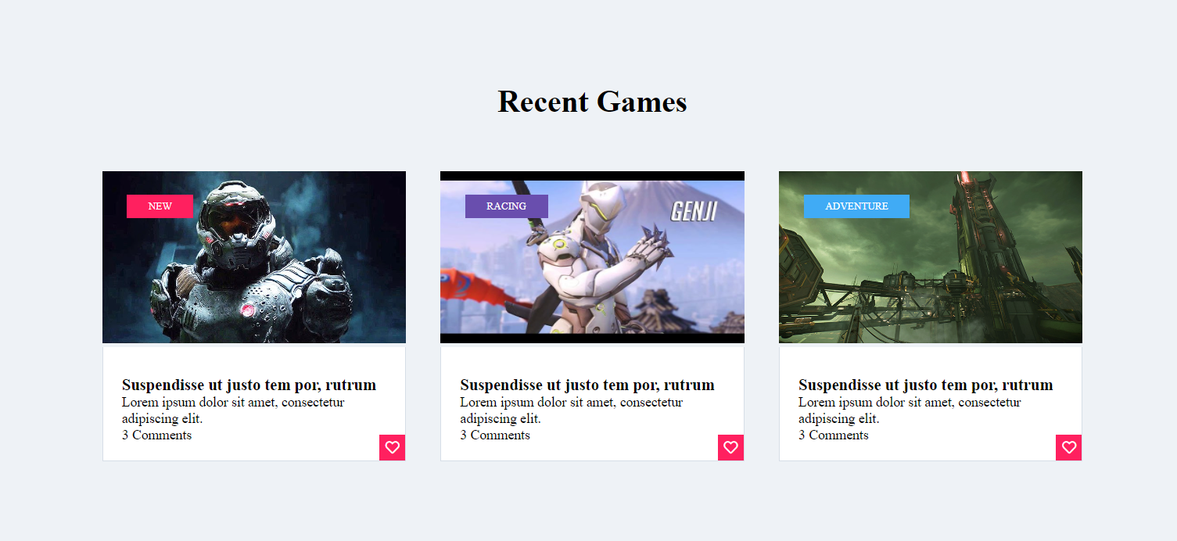
A SNAPSHOOT OF OUR GAMES & RECENT ONES

Slide 10
A SNAPSHOOT OF OUR GAMES & RECENT ONES

Slide 11
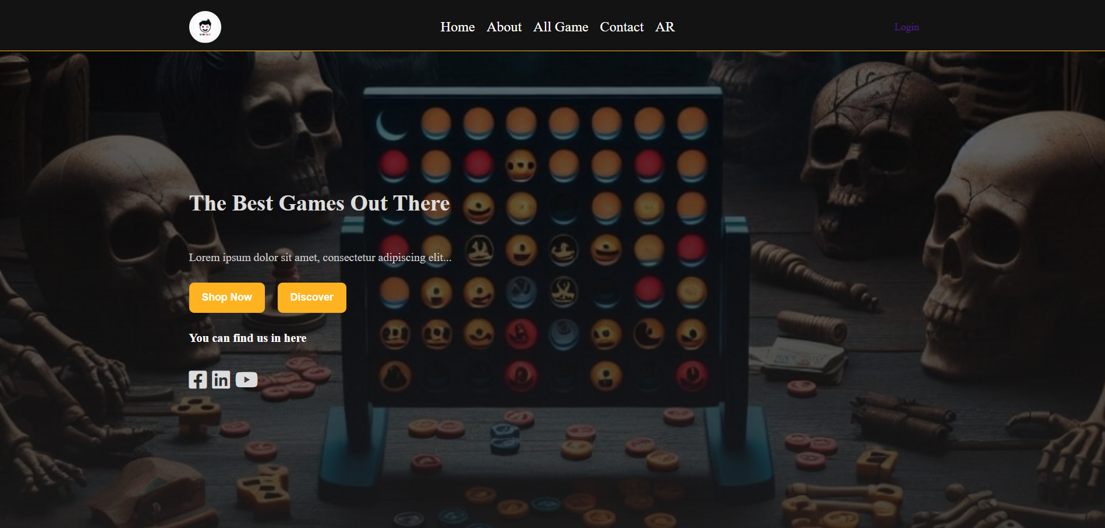
CONNECT-4 PROJECT HOME PAGE
Connect 4 is a classic strategy game reimagined for the digital age. Players compete to align four of their pieces in a row, either horizontally, vertically, or diagonally. The game encourages strategic thinking and friendly competition.
Home Page Content
The homepage of Connect 4 features vibrant graphics, a clear call-to-action for new players, and easy navigation to sign up or log in. Highlights include game instructions, player leaderboards, and featured community events.

Slide 12
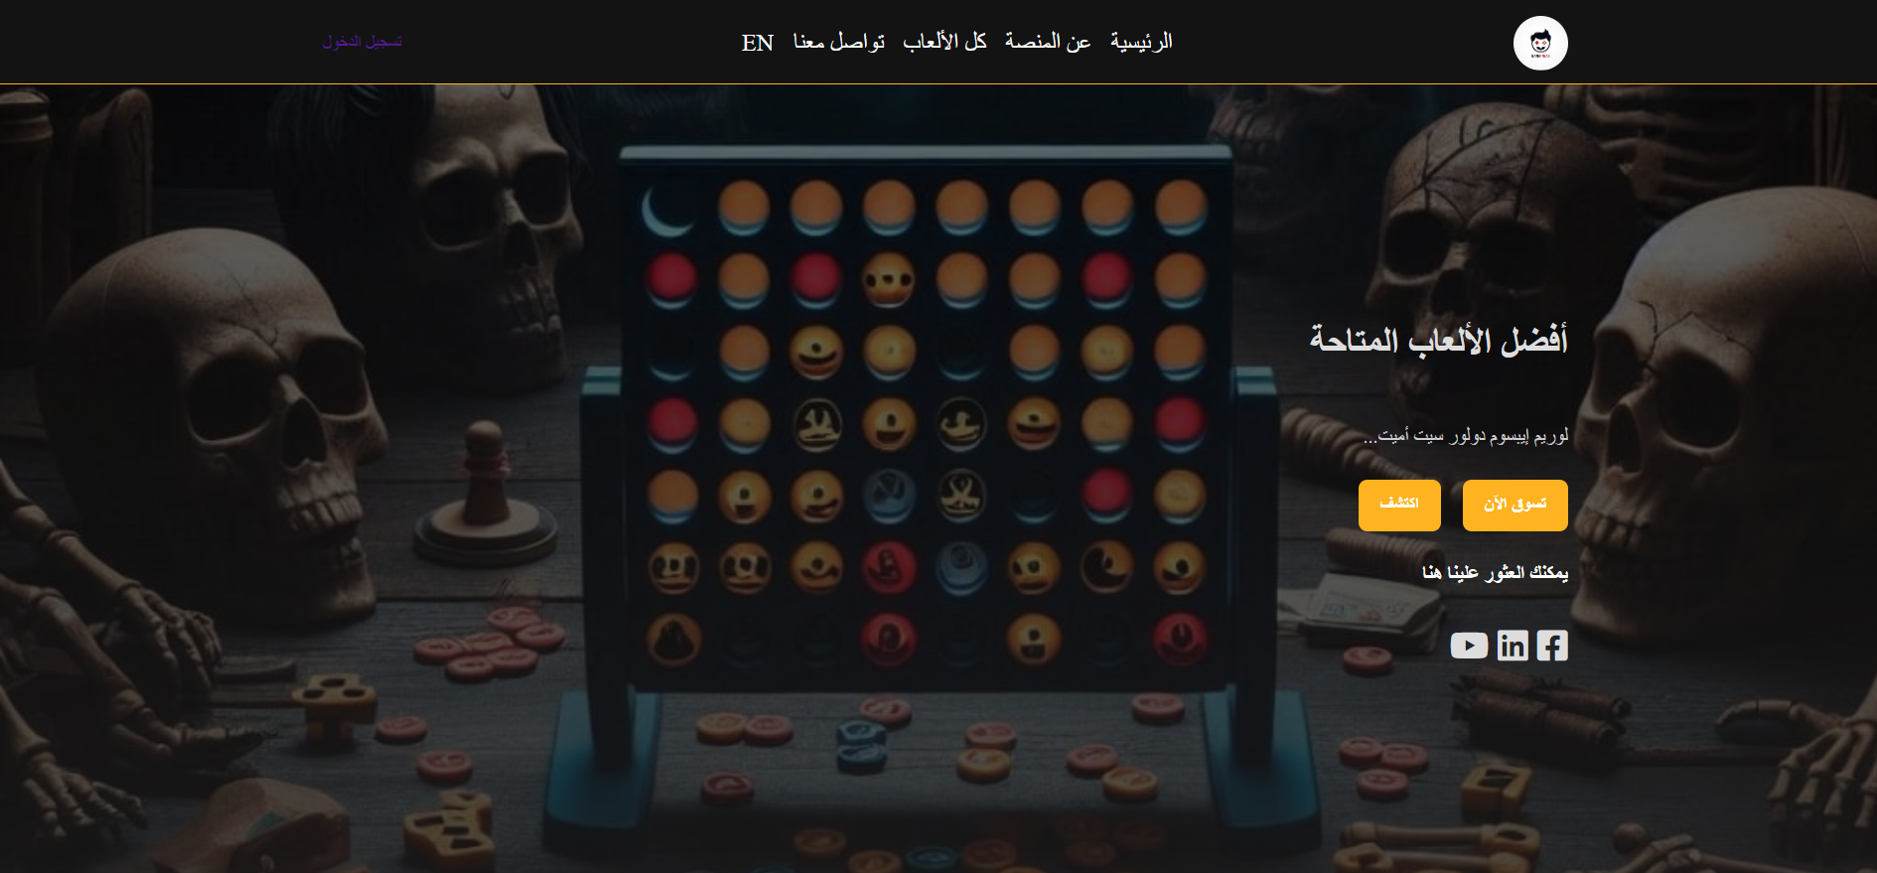
LANGUAGE CONVERTOR PRIVACY
Our system can support the language conversion between Arabic & English

Slide 13
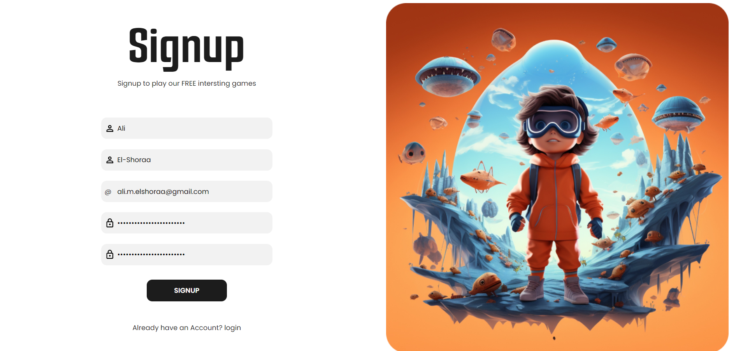
SIGN UP STEPS
Visit the Connect 4 homepage.
Click on the "Sign Up" button.
Fill out the registration form with your details (name, email, password).
Verify your email address.
Start playing!

Slide 14
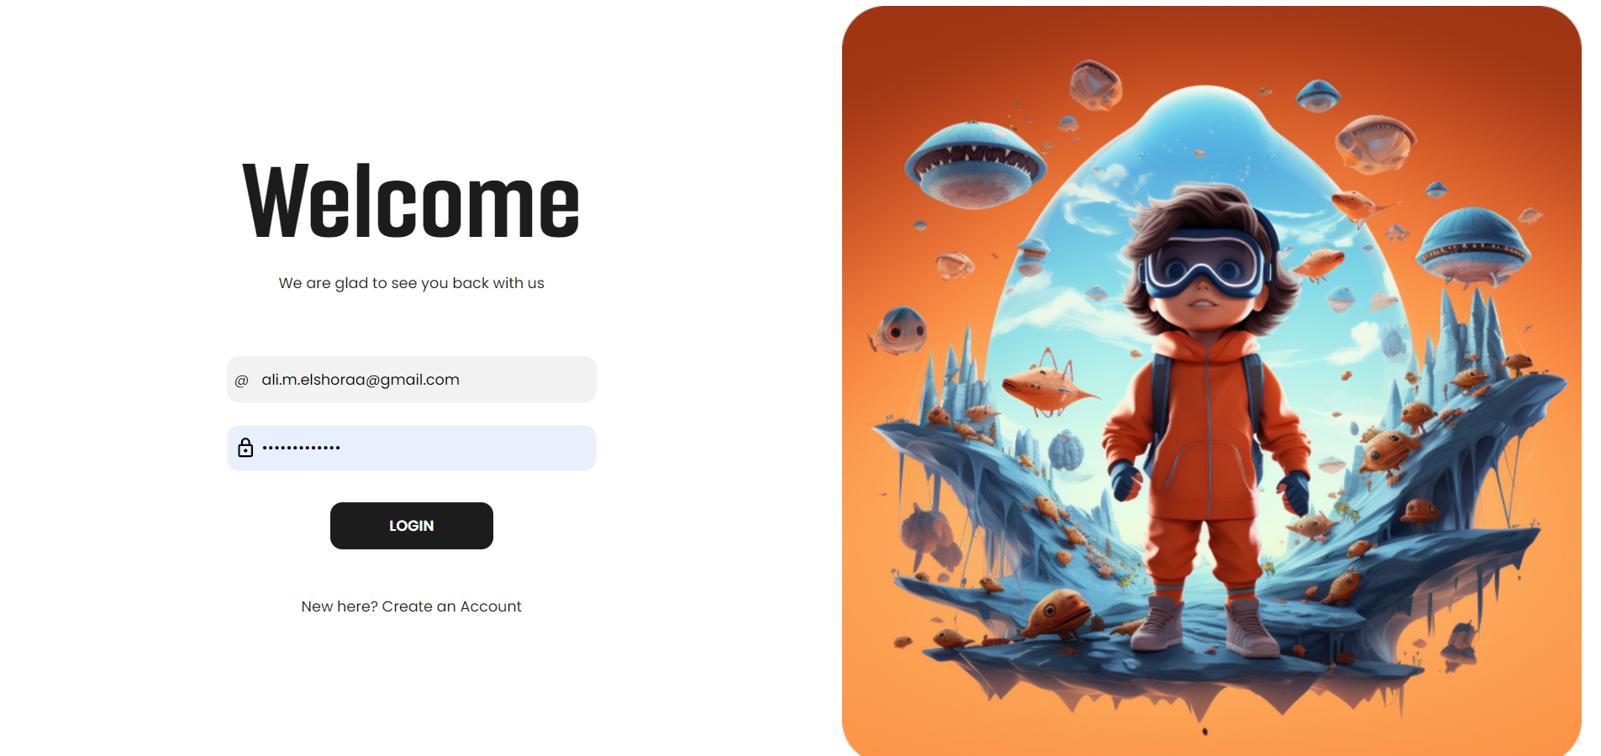
LOGIN PAGE
Go to the Connect 4 homepage.
Click on the "Login" button.
Enter your registered email and password.
Click "Submit" to access your account and start playing.

Slide 15
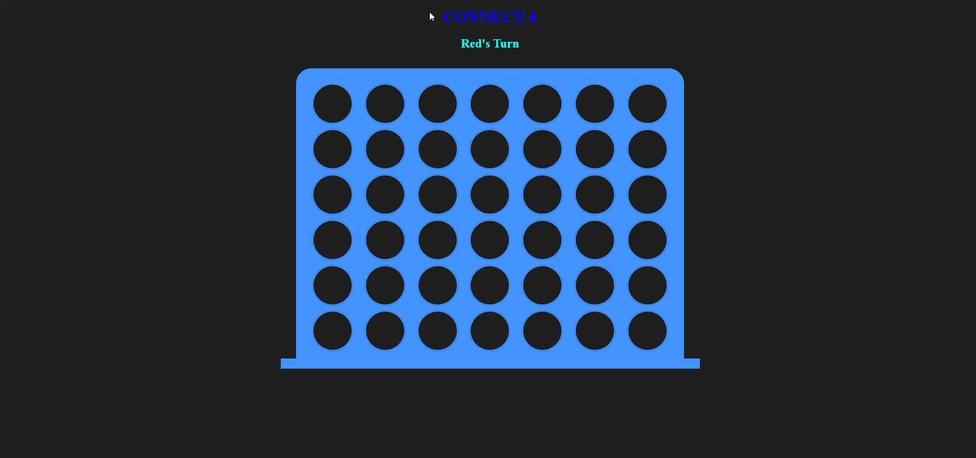
FINAL PRODUCT & GAME TOTURIAL
The game tutorial guides new players through the rules and strategies, ensuring they can quickly learn and enjoy the game.
Link to the tutorial:www.http/gamefreak.com

Slide 16
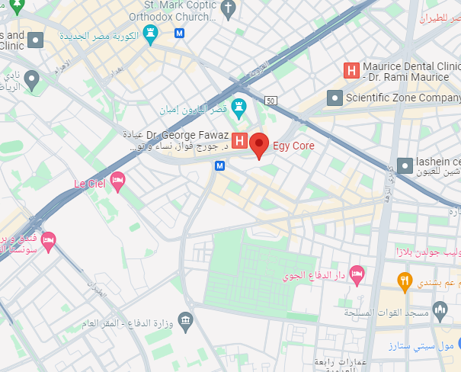
Contact US
For more information or inquiries, please contact us:
Headquarter: 79, El Merghany St., Heliopolis – Cairo – Egypt.
Tel: + (202) 207 2414 8 / 01224416955
Email: sales@gamefreak.com

